Slide 1

FOODEMY
COOK . LEARN . TEACH

Slide 2
WHAT IS FOODEMY ?
FOODEMY IS A PLATFORM BY WHICH YOU GET A CHANCE TO LEARN COOKING VIA TUTORIALS AND RECEIPES THROUGH PROFFESIONALS.
THIS IS A PLATFORM WHERE YOU CAN SHARE YOUR RECEIPES AND VIDEOS SO THAT OTHERS CAN HAVE THE TASTE OF YOUR SPECIAL DISHES

Slide 3
WHY FOODEMY ?
This is a platform solely dependent on cooking related things only , unlike YouTube and other applications if you will search a recipe only relevant and the popular videos will be displayed to you.
This platform gives you a chance to learn from other people’s recipes and also you can provide your own videos or recipes so that others can learn your secret recipes.

Slide 4
TOOLS USED
VSCODE – Used as a coding platform.
CSS – Used to style the website
HTML – To add every element to the website.
JAVASCRIPT – To make the website interactive.
FIGMA – Used to create attractive logos.

Slide 5
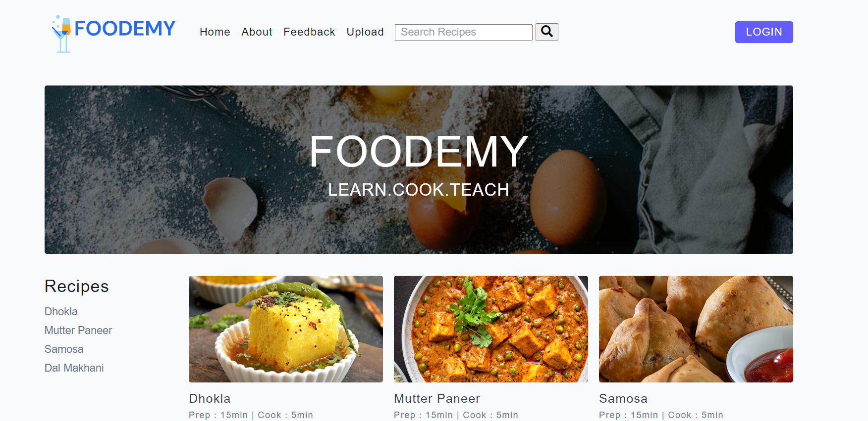
INTERFACE

Slide 6
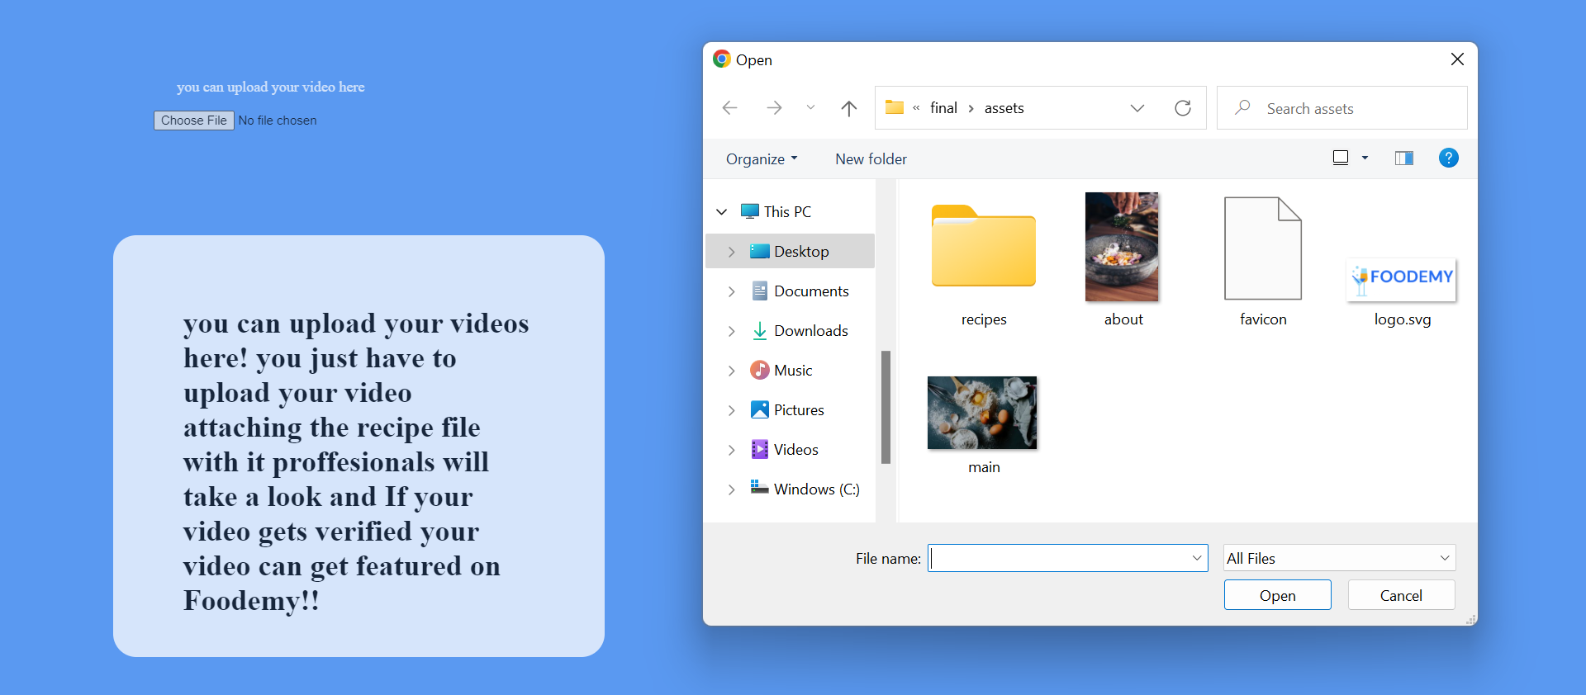
UPLOAD INTERFACE

Slide 7
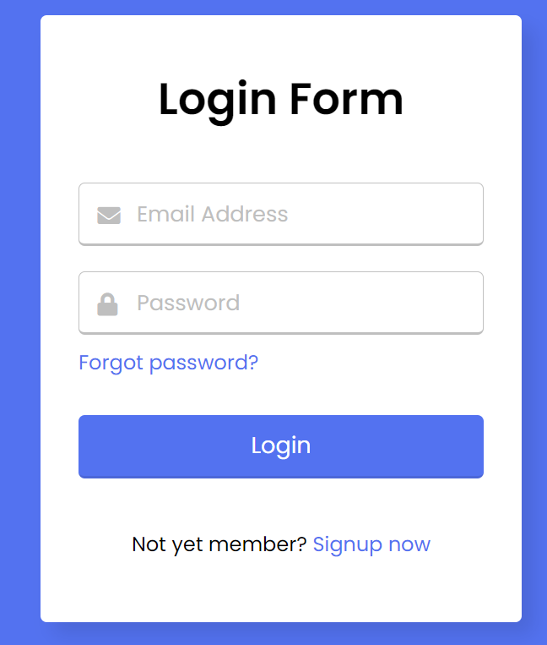
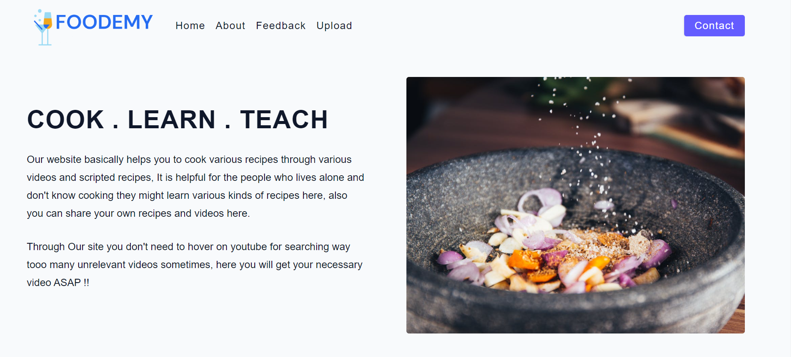
FEATURES
About
LOGIN / SIGNUP

Slide 8
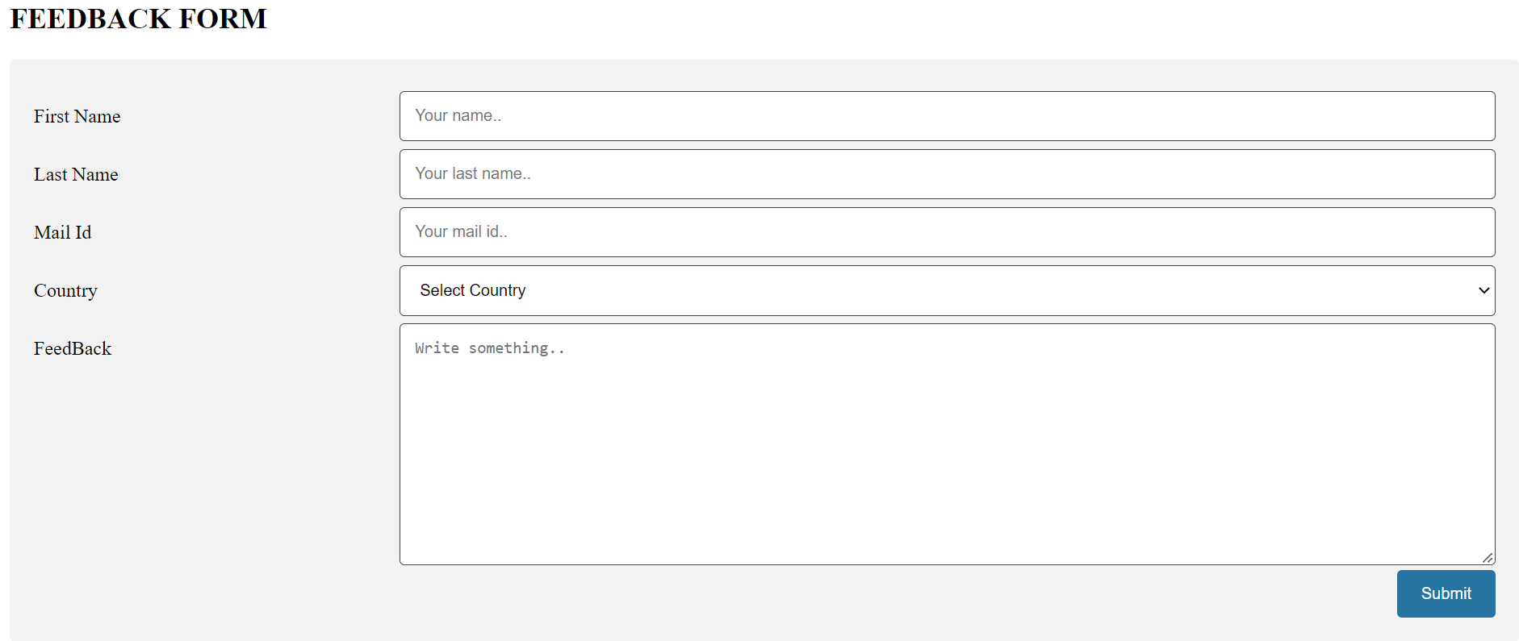
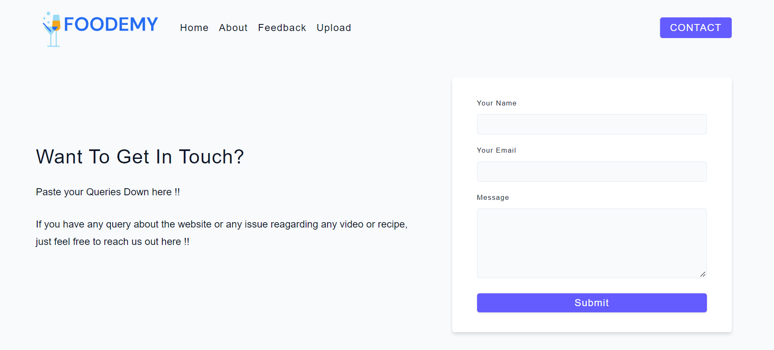
FEATURES
FEEDBACK
CONTACT

Slide 9
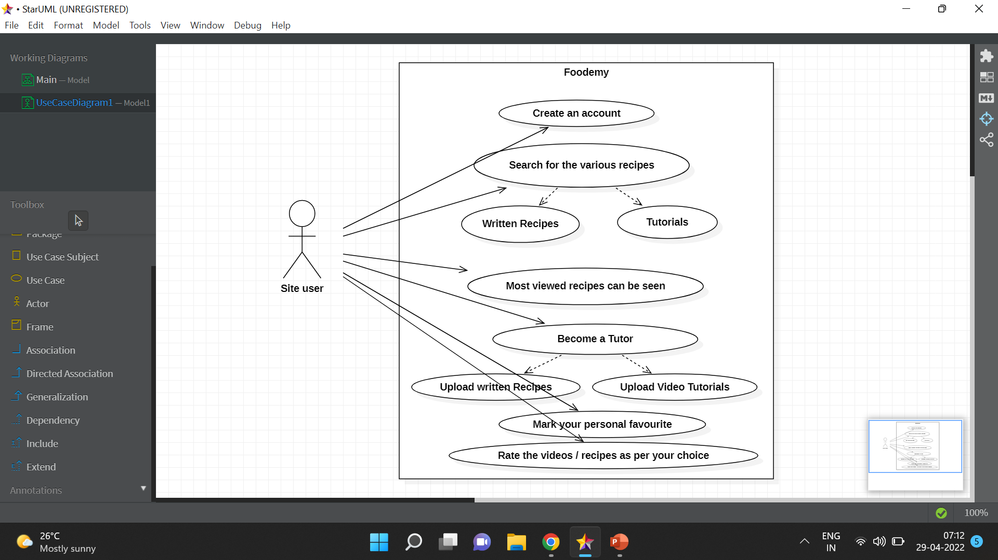
USE CASE

Slide 10
FUTURE SCOPE
As the whole world is shifting their work online FOODEMY would be helpful to learn cooking from anywhere at anytime.
With further updates we plan to make special program for the tutors that once they and their contents gets verified by our team they may get revenue.

Slide 11
Presented By :
THANKYOU !!
Shweta – 2205058
Deep – 2205052
Saket – 2205028
Ayush Neelkanth -2205007
Project Guide :
Prof. Ayesha Butalia

